Slide 1
CASTONE PROJECT
KEYLOGGERS AND SECURITY
VASUNDRA LAKSMI G V
ANJALAI AMMAL MAHALINGAM ENGINEERING COLLEGE
DEPARTMENT OF INFORMATION TECHNOLOGY

Slide 2
OUTLINE
Proposed system / solutions
System Development Approach
Problem statement
Algorithm & Deployment
Result
Conclusion
Future scope
References

Slide 3
PROBLEM STATEMENT
Increasing instances of keylogger attacks pose a significant threat to personal and organizational cybersecurity. Keyloggers, a form of malicious software, surreptitiously capture keystrokes on computing devices, compromising sensitive information such as passwords, credit card numbers, and confidential data.
These stealthy threats undermine privacy, financial security, and the integrity of digital transactions, leading to financial losses, identity theft, and reputational damage.
Current cybersecurity measures often fail to adequately detect and prevent keylogger infections, leaving individuals and businesses vulnerable to exploitation.

Slide 4
PROPOSED SYSTEMS AND SOLUTION
Keyloggers pose a significant threat to the security and privacy of individuals and organizations alike. These malicious software programs surreptitiously record keystrokes made by users on computers and mobile devices, allowing attackers to capture sensitive information such as passwords, credit card numbers, and personal messages.
The presence of keyloggers can result in devastating consequences, including identity theft, financial loss, and unauthorized access to confidential data. Moreover, keyloggers often operate stealthily in the background, making them difficult to detect using traditional security measures.

Slide 5
SYSTEM DEVELOPMENT APPROACH
Requirement Analysis: Begin by understanding the specific requirements and objectives of the system. Identify the target platforms (e.g., Windows, macOS, Android, iOS).
Research and Threat Modeling: Conduct thorough research on keylogger techniques, including how they operate, common attack vectors, and methods used to evade detection.
System Design: Design the architecture of the keylogger detection and prevention system. Determine the components required, such as monitoring agents, detection algorithms, user interfaces, and reporting mechanisms
Development: Develop the system components according to the design specifications. Implement detection mechanisms to identify keylogger activity, such as monitoring keyboard input, analyzing system processes, and detecting suspicious behavior.

Slide 6
ALGORITHM
Data Collection: The system collects data from various sources, including keyboard input, system processes, and network traffic.
Feature Extraction: Relevant features are extracted from the collected data, such as keystroke timing, frequency of keyboard input, process behavior, and anomalies in network traffic.
Machine Learning Model Selection: Depending on the requirements and available data, suitable machine learning algorithms are chosen for keylogger detection, such as supervised or unsupervised learning.
Training Data Preparation: A labeled dataset is prepared, consisting of examples of normal and malicious behavior. This dataset is used to train the machine learning model.
Training the Model: The machine learning model is trained using the prepared dataset to classify instances of keylogger activity accurately.

Slide 7
DEPLOYMENT
Preparation and Planning: Before deployment, thoroughly assess the organization's infrastructure, including network architecture, endpoints, and existing security measures. Define deployment goals, objectives, and success criteria. Determine the scope of deployment, including the number of devices and users to be covered.
System Configuration: Configure the keylogger detection and prevention system according to the organization's specific requirements and security policies. Customize settings, rules, and policies based on the organization's risk tolerance and compliance requirements.
Testing and Validation: Conduct comprehensive testing of the deployed system in a controlled environment to ensure proper functionality and performance. Validate the system's effectiveness in detecting and preventing keylogger activity using simulated attacks, real-world scenarios, and diverse usage patterns.
User Training and Awareness: Provide comprehensive training to system administrators, security personnel, and end-users on the features, capabilities, and best practices associated with the keylogger detection and prevention system.

Slide 8

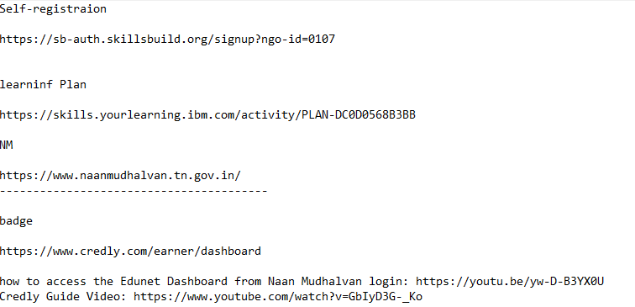
RESULT

Slide 9
CONCLUSION
keyloggers represent a significant threat to cybersecurity, capable of compromising sensitive information and undermining the integrity of systems and networks. However, through proactive measures such as deploying keylogger detection and prevention systems, organizations can effectively mitigate these risks. By leveraging advanced algorithms, continuous monitoring, and user awareness initiatives, these systems provide a robust defense against keylogger attacks. Furthermore, the implementation of such systems underscores the organization's commitment to safeguarding data privacy and maintaining the trust of stakeholders. As cybersecurity threats continue to evolve, investing in keylogger detection and prevention measures remains essential to maintaining a resilient security posture in today's digital landscape.

Slide 10
FUTURE SCOPE
Continued research into machine learning, artificial intelligence, and behavioral analytics will lead to more sophisticated detection techniques for identifying keylogger activity. This includes the development of anomaly detection algorithms capable of recognizing subtle deviations from normal behavior.
As the use of endpoints such as laptops, smartphones, and IoT devices continues to proliferate, future solutions will prioritize endpoint protection against keylogger attacks.
The adoption of behavioral biometrics, such as keystroke dynamics and mouse movements, offers potential for more secure authentication methods. Future systems may leverage these biometric traits for user authentication, providing an additional layer of defense against keylogger attacks.
Integration of blockchain technology can enhance the security of data transmission and storage, making it more difficult for keyloggers to intercept and manipulate sensitive information.

Slide 11
REFERENCE
Stallings, W., & Brown, L. (2017). "Computer Security: Principles and Practice." Pearson.
Sikorski, M., & Honig, A. (2012). "Practical Malware Analysis: The Hands-On Guide to Dissecting Malicious Software." No Starch Press.
Anderson, R. (2008). "Security Engineering: A Guide to Building Dependable Distributed Systems." Wiley.
Goodrich, M. T., & Tamassia, R. (2014). "Introduction to Computer Security." Pearson.

